Slide 1
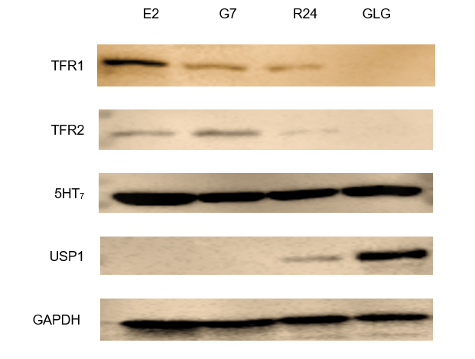
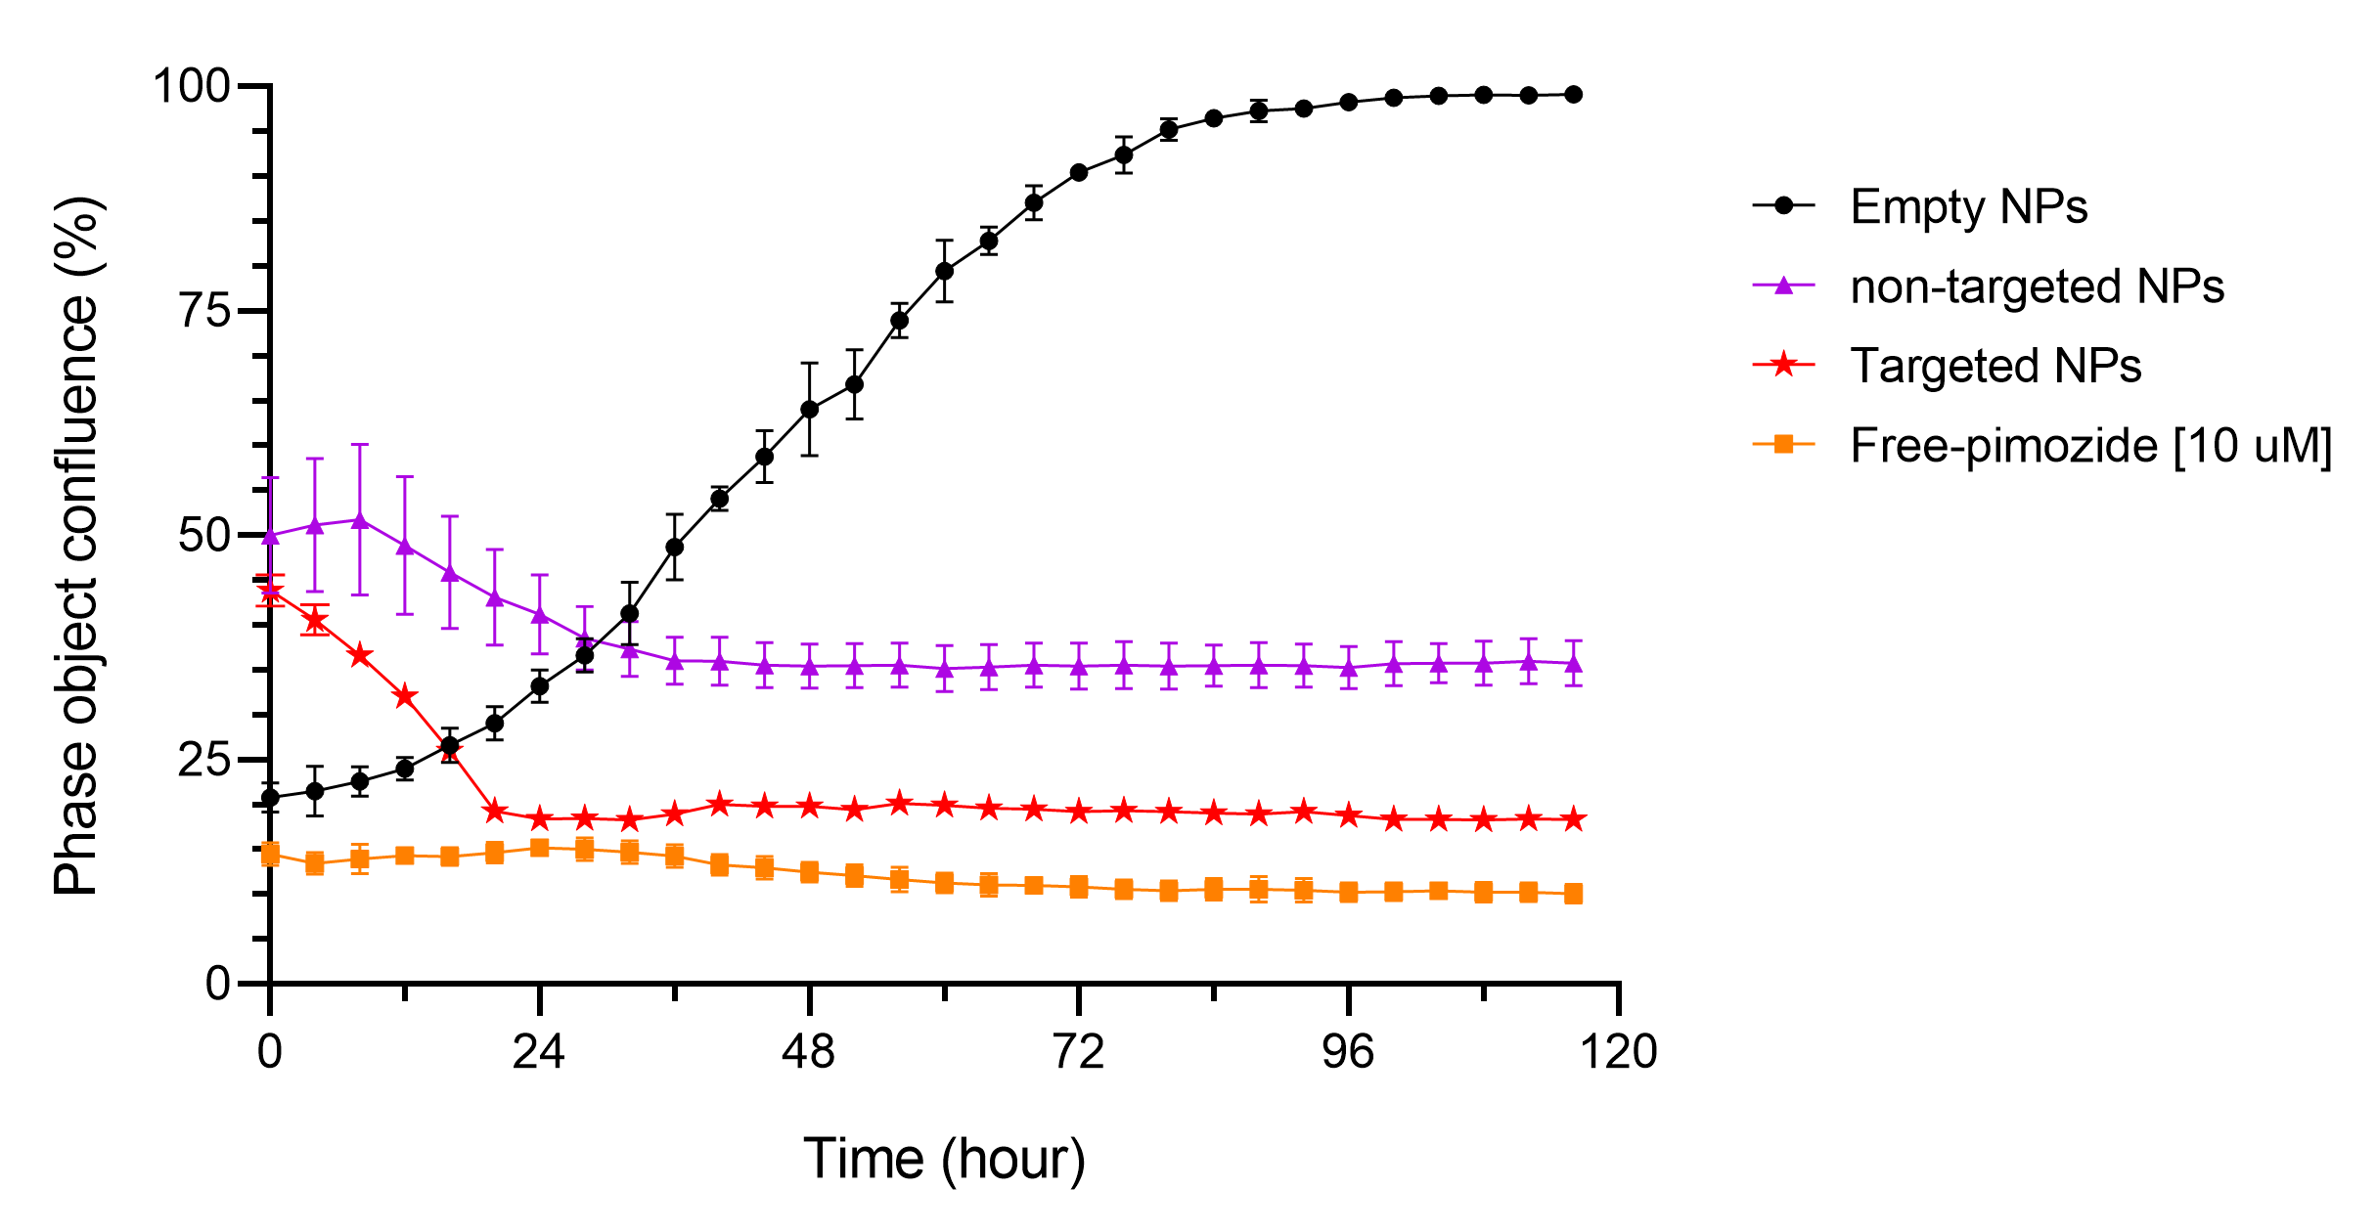
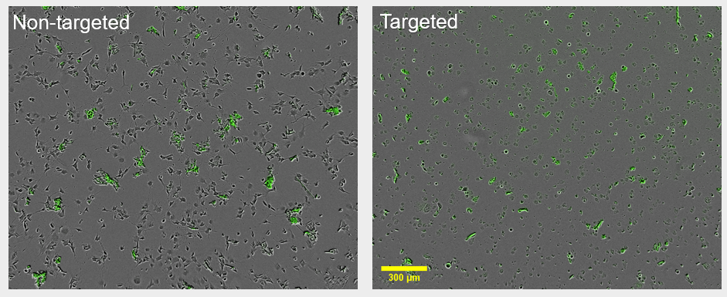
Novel Formulation of PGLA nanoparticles for targeted glioblastoma chemotherapy
Nazim Uddin¹, Amal Elkordy², Ahmed Faheem³
School of Pharmacy and Pharmaceutical Sciences, University of Sunderland, Sunderland, United Kingdom
¹ nazim.uddin@research.sunderland.ac.uk; ² amal.elkordy@sunderland.ac.uk; ³ ahmed.faheem@sunderland.ac.uk
Introduction
Materials & Methods
Poly-lactide-co-glycolide (PLGA) is a biodegradable polymer that has been approved by U.S Food Drug Administration (FDA) and European Medicines Agency (EMA) for therapeutic use in human. Furthermore, it is being extensively studied as nanoparticulate drug delivery system. The most attractive feature of PLGA nanoparticles is that they could be tuned into functionalized nanoparticles having desired physicochemical properties. In particular, active targeting can be made possible with PLGA nanoparticle by conjugating targeting ligand within the PLGA.
Pimozide is a first-generation antipsychotic drug used in schizophrenia and Tourette syndrome, and other psychotic disorder. Interestingly, it was reported as anticancer agent in several studies. However, no study has developed pimozide formulation aiming for cancer therapy.
Glioblastoma is a deadly brain cancer that is not completely treatable with current clinical interventions. Studies suggest that antipsychotic agent pimozide inhabits glioblastoma cells. However, using free-pimozide for glioblastoma chemotherapy only would not be possible as it would induce severe side effects, along with its antipsychotic effect. Targeted delivery of pimozide by PLGA nanoparticles could be a potential therapeutic option for glioblastoma. However, blood-brain barrier (BBB) poses a threat to nanoparticles. In this case, PLGA nanoparticles functionalised with transferrin (TF) could selectively target transferrin receptor (TFR) proteins that are expressed by BBB lining capillary endothelial cells. PLGA-TF complex would be then transported across the BBB by clathrin-mediated endocytosis.
Interestingly, glioblastoma cells overexpress TFR receptors, which would be again selectively targeted by PLGA-TF nanoparticles (1-6).
Therefore, we aim to developed PLGA-PEG nanoparticles to target glioblastoma.
Nanoparticles were prepared by a staggered herringbone micromixing method, using a benchtop NanoAssemblr® (Precision NanoSystems™, Canada). Particle size and charge were analysed by dynamic light scattering (DLS), using Zetasizer ZSP instrument (Malvern Panalytical, UK). Drug encapsulation efficiency (EE) was analysed by a validated ultra-high-performance liquid chromatography (UHPLC). The morphology of the nanoparticles was analysed by transmission electron microscopy (TEM). Adsorbed transferrin (TF) on the nanoparticles was quantified by an indirect method using micro-BCA protein assay.
For in vitro evaluation, patient-derived glioblastoma cell lines, namely E2, G7, R24, and GLG were cultured on advanced Dulbecco’s modified Eagle medium (DMEM). Transferrin receptors (TFR) expression on these four cell lines was investigated by Western blot analysis. Finally, the cytotoxicity of targeted nanoparticles was evaluated on the cell line that mostly expressed TFR, performing cell proliferation assay using a live-cell analysis system IncuCyte® ZOOM (Essen BioScience, UK).
Figure 1: Western blot analysis showing TFR expression on glioblastoma cell lines.
Results
Figure 2: Cytotoxicity of targeted nanoparticles (PLGA-PEG-TF) on glioblastoma cell line E2.
Increased particle size (observed by DLS) confirmed TF adsorption on PLGA (Table 1). Further, TEM and BCA protein assay confirmed the transferrin adsorption (data not shown).
Western blot analysis showed that two types of TFR receptors (TFR1 and TFR1) were expressed on three cell lines out of four tested in this study (Figure 1). It can be observed that TFR1 was expressed most on E2 cell line.
Accordingly, cell proliferation assay of E2 cell line showed that PLGA-PEG-TF nanoparticles effectively inhibited the growth of glioblastoma cells (Figure 2). This finding was further supported by the phase contrast images that were taken after treatment of nanoparticles (Figure 3).
Figure 3: Phase contrast images of glioblastoma cells at day 3 after treated with targeted and non-targeted PLGA nanoparticles.
Aims and Objectives
This study aims to develop targeted nanoparticles (PLGA-PEG-TF) and evaluate them on glioblastoma cell lines.
The objectives of this study are-
• To functionalize PLGA-PEG nanoparticles with transferrin.
• To confirm the expression of TFR proteins on glioblastoma cell lines.
• To evaluate the cytotoxicity of PGLA-PEG-TF nanoparticles on glioblastoma cell line.
Table 1: Physicochemical properties of nanoparticles
Conclusions
NPs | Particle size (nm) | Zeta potential (mV) | Encapsulation efficiency (%)
PLGA-PEG | 61 ± 1 | -18 ± 2 | 73 ± 4
PLGA-PEG-TF | 74 ± 6 | -10 ± 2 | 47 ± 3
This study aimed to target glioblastoma cells with pimozide-encapsulated PLGA-PEG-TF nanoparticles that would, when treated, selectively bind with TFR on the cell surface, and get internalized by clathrin-mediated endocytosis. Thus, pimozide would only kill glioblastoma cells if delivered with targeted nanoparticles.
Our results, with sub 100 nm particle size even after TF adsorption, ~50% drug encapsulation efficiency, positive TFR expression on glioblastoma cells, and effective inhibition of glioblastoma cell growth, support the hypothesis. However, in vivo studies are required for its development into nanomedicines.
Contact
References
Nazim Uddin
Pasteur 162, Sciences Complex
School of Pharmacy and Pharmaceutical Sciences
University of Sunderland, United Kingdom
Email: nazim.uddin@research.sunderland.ac.uk
Phone: +4401915154014, +4407824809123
1. Bidkar, A. P., Sanpui, P., & Ghosh, S. S. (2020). Transferrin-Conjugated Red Blood Cell Membrane-Coated Poly(lactic-co-glycolic acid) Nanoparticles for the Delivery of Doxorubicin and Methylene Blue. ACS Applied Nano Materials, 3(4), 3807–3819. https://doi.org/10.1021/acsanm.0c00502
2. Calzolari, A., Larocca, L. M., Deaglio, S., Finisguerra, V., Boe, A., Raggi, C., Ricci-Vitani, L., Pierconti, F., Malavasi, F., De Maria, R., Testa, U., & Pallini, R. (2010). Transferrin Receptor 2 Is Frequently and Highly Expressed in Glioblastomas. Translational Oncology, 3(2), 123–134. https://doi.org/10.1593/tlo.09274
3. Chang, J., Jallouli, Y., Kroubi, M., Yuan, X., Feng, W., Kang, C., Pu, P., & Betbeder, D. (2009). Characterization of endocytosis of transferrin-coated PLGA nanoparticles by the blood–brain barrier. International Journal of Pharmaceutics, 379(2), 285–292. https://doi.org/10.1016/j.ijpharm.2009.04.035
4. Lee, J. K., Nam, D.-H., & Lee, J. (2016). Repurposing antipsychotics as glioblastoma therapeutics: Potentials and challenges (Review). Oncology Letters, 11(2), 1281–1286.
5. Rath, B. H., Camphausen, K., & Tofilon, P. J. (2016). Glioblastoma radiosensitization by pimozide. Translational Cancer Research, 5(6), S1029–S1032. https://doi.org/10.21037/10584
6. Svenja, Z., N, M., M, M., K, A.-E.-A., F, R., Sjl, van W., D, K., & S, F. (2018, September 24). Loperamide, Pimozide, and STF-62247 Trigger Autophagy-Dependent Cell Death in Glioblastoma Cells. Cell Death & Disease; Cell Death Dis. https://doi.org/10.1038/s41419-018-1003-1.

